Slide 1
Bright House Financials – OnBoarding Reference

Slide 2
About Brighthouse Financials (BHF)
BHF is one of the largest providers of annuities and life insurance in the U.S
Couple of years back BHF completed its separation from MetLife and began trading on the Nasdaq stock exchange. Even on separation, MetLife retained a some percentage of stake in the company.
Headquartered in Charlotte, NC

Slide 3
Scope Overview
VMs: 263
(Azure - 93, AWS - 74, SoftLayer - 96)
Users: 3000
Locations: 6 (Charlotte, Tampa, Convent
Station, NYC, Phoenix, Boston)
Mobile: 1028 (149- Android, 879- iOS)
Polycom Phones – 1205 (Desk Phone - 1159; Video Conference - 46
Printers - 46
Network POTS/ATAs: 76
VDIs: 1129
Endpoint Agents - 2757
SIEM EPS - 2500;
Privileged Accounts - 400
Firewall Devices – 16
Infra Vulnerability Mgmt. – 293 IP’s
Routers: 40; Switches: 136
Wireless Access Points: 220
Infoblox: 7
O365 Mailboxes: 2551
SharePoint Sites: 94 Site Collection,315 Subsites
Application Packages: 12/month
Cloud Computing:
Azure, AWS Cloud operations, Server management, RedHat Openshift
Network Services:
LAN, SDWAN, VPN, WAN connectivity
End User Computing:
Device support, Desktop engineering, O365, MDM, Print Services
Security:
SecOps, VM, end point protection, DLP
SCOPE OF
SERVICES
Multi-vendor support
Managed Services
Dedicated resource model
Dedicated resources for Projects
DELIVERY MODEL
VOLUMETRICS
Monitoring Tools : Cloud native, Solarwinds
Backup : OneDrive, Native Backup
VDI : Horizon / WVD
MDM : Intune
Patch : SCCM
Reporting & Log : ELK
CMP : ServiceNow CMP
Cyber Threat Defense Platform
Cloud Economics: Cloudyn
TOOLS
TECHNOLOGY
BHF
Overview
Azure, AWS
OpenShift
Windows, Linux
Azure AD Backup, File
MS SQL
Qualys; IBM QRadar
Metaspolit
SkyHigh CASB
Symantec (Bluecoat)
CyberArk, OpenText
Cisco Meraki
O365 suite
Horizon VDI
Symantec SEP
Cisco/ Fortinet
Proofpoint
Carbon Black
Wombat
Century link SDWAN; ECX
Out of scope
L1 & monitoring
Service Desk
Service Management Office
Field Services desk-side support
ITSM & Process
Audio, Video services
Conferencing services
Digital signage services

Slide 4



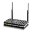
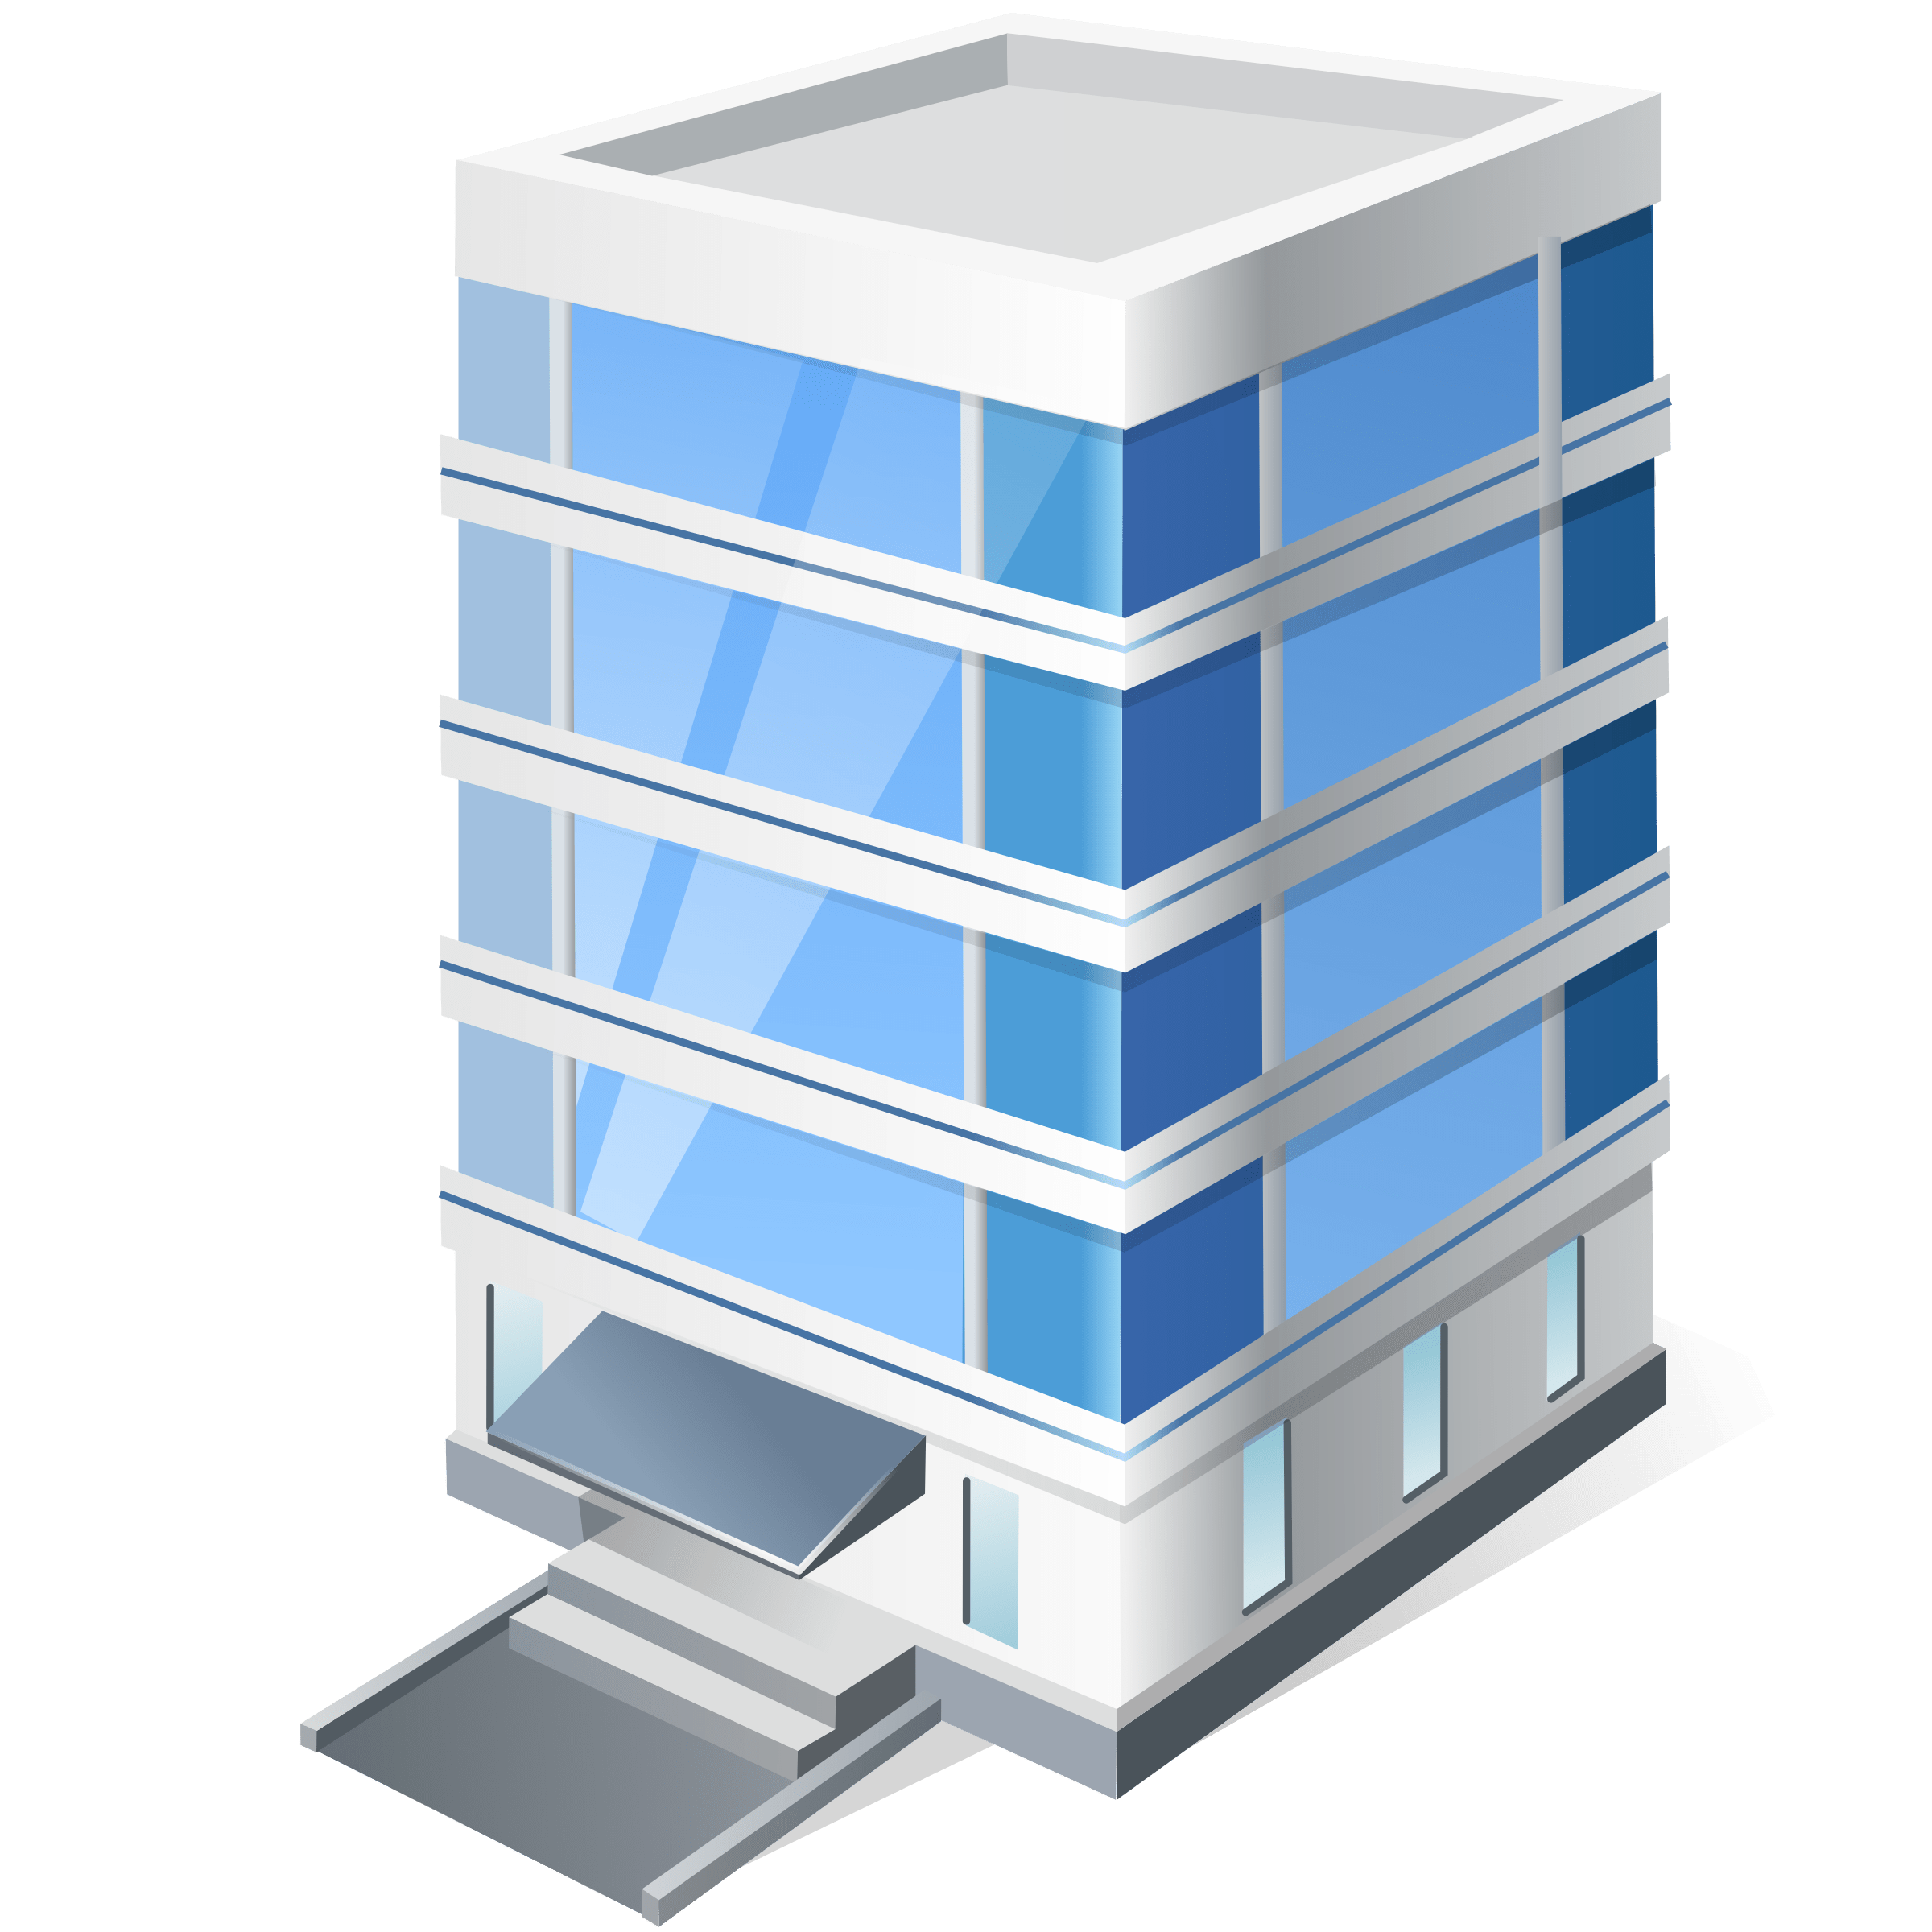
Current Vs. Target Environment
BHF Current Environment
BHF Target Environment
IaaS
IaaS
74
IBM Softlayer
78
12
74
IBM Softlayer
78
12
4
12
MS DNS
4
12
MS DNS
VMs from SL
BHF
BHF
BHF
Equinix CoLo DC
Equinix CoLo DC
BHF
IBM Rack
Cognizant Rack
WLAN, LAN Switches & Routers -
Meraki AP, MX & MS
Core Routers, VRF, BGP Endpoints - Cisco ASR 1001 - X
WLAN, LAN Switches & Routers -
Meraki AP, MX & MS
Core Routers, VRF, BGP Endpoints - Cisco ASR 1001 - X
Firewall - Cisco ASA
Firepower 4120
NACL –
Cisco ISE
Firewall - Cisco ASA
Firepower 4120
NACL –
Cisco ISE
WAN Connectivity to
Cloud/SaaS Providers - ECX
Cabling - Comnet
WAN Connectivity to
Cloud/SaaS Providers - ECX
Private B2B MPLS circuit - CenturyLink
DHCP - Infoblox
Cabling - Comnet
Private B2B MPLS circuit - CenturyLink
DHCP - Infoblox
Internet Circuits - CenturyLink
Internet Circuits - CenturyLink
Equinix Colo- ECX CoLo DC
Equinix Colo- ECX CoLo DC
BHF Sites
BHF Sites
Boston
Charlotte
Convent Station
New York
Tampa
Phoenix
Boston
Charlotte
Convent Station
New York
Tampa
Phoenix
BHF
Cabling - Comnet
WLAN, LAN Switches & Routers -
Meraki AP, MX & MS
Cabling - Comnet
WLAN, LAN Switches & Routers -
Meraki AP, MX & MS
Internet Circuits - CenturyLink
ATA Gateway – Lexair Grandstream
Internet Circuits - CenturyLink
ATA Gateway – Lexair Grandstream
Analog phone lines for Faxing - Lexair
Analog lines for Conf - Lexair
Firewall - Fortigate
Analog phone lines for Faxing - Lexair
Analog lines for Conf - Lexair
Firewall - Fortigate
Legend
Decommission in progress

Slide 5


















Overall Target Operating Model
BHF Retained Organization – Enterprise IT Strategy | Architecture | Governance | Infrastructure Planning
BHF IT Landscape
Public Cloud
Dedicated Hosting
SaaS
Equinix Colo DCs
BHF Sites
BHF Users
Tools
Owned / Managed by BHF & 3rd party vendors
Owned by BHF & Managed by Cognizant
Owned & Managed by Cognizant
CMP
AWS Cloudwatch
Azure Cost Manager
Azure Monitor
Platform
Cyber Threat Defense Platform
Integrated Smart Operations
Integrated Operations Support for Cloud, Network, EUC - (24x7) & Security Operations Center (24x7)
Service Management Office
Service Desk
Backup | Patch Management | Reporting | Incident Response & Tracking | Coordination | Security Monitoring
Cloud
Network
EUC
Security
Projects
Cloud Architects
& Admins
Cloud Operations | Cost Management
Network Architects & Engineers
LAN | VPN
| WAN | ECX
Device Technicians & Desktop Engineers
Desktop Engg. | VDI | MDM | O365
Security Architect & Consultants
End point protection |
IDS/IPS | VM | DLP | IAM | DS
Small Projects
SaaS Onboarding
Other Project related activities
Enterprise Architects | ITSM / SIAM Liaison | Delivery Mgmt | Automation | Capacity & Performance Mgmt | Contract Mgmt
Supporting Functions
Centers of Excellence | Innovation council | HR | Finance | Contract Management | Partners/Alliances | Domain Consultants
Support
Responsibility
BHF
Vendor
BHF
Cognizant

Slide 6

Delivery Location & Roles
Support Highlights
24x7 support operations from offshore
Onsite SME presence covering business hours
Offshore SME presence covering 16 x5
On call SME support during off business hours for P1 Incidents
Charlotte, NC, USA
Chennai, TN, India & Bangalore**, KA, India
Solution Delivery Manager
Enterprise Architect
Cloud Architect
Network Architect
Security Specialist
Desktop / Mobility Specialist
ISAM Liaison Specialist
Cloud Engineers
Network Engineer
Security Administrator
Remote Desktop/Mobility Support Engineer
Integrated/Smart Operations
Capacity and Performance Manager
SI and CMG
Reporting
Onsite SME Presence
Mon-Fri
Offshore SME Presence
Mon-Fri
Offshore SME On Call
Mon-Fri
Offshore/Onsite SME On Call
Sat-Sun
Offshore Smart / Integrated Operations
Mon-Sun
**Dual location strategy adopted for Disaster recovery / BCP

Slide 7
Resource Distribution – Year 1* Year 2 onwards few rotations are expected.
Tower | Onsite/Offshore | Planned onboarding | Identified
Integrated Ops | Offshore | 6 | 2
Cloud BAU +Automation | Offshore | 4 | 2
Cloud Architect + Automation | Onsite | 2 | 1
Network BAU + Solarwinds | Offshore | 4 | 1
Network Architect | Onsite | 1 | 1
EUC | Offshore | 10 | 6
EUC | Onsite | 2 | 0
Architect | Onsite | 1 | 1
Capacity & Performance Manager | Offshore | 1 | 1
Reporting | Offshore | 1 | 1
CMG | Offshore | 1 | 0
SNOW-Liaison | Onsite | 1 | 1
Delivery Management-BAU | Offshore | 3 | 2
Delivery Management-BAU | Onsite | 1 | 1
SI | Offshore | 1 | 0
Projects | Offshore | 4 | 0
Projects | Onsite | 4 | 2
Security BAU | Offshore | 16.2 | 3
Security Architect | Onsite | 1.25 | 1
Transition Mgmt AD | Onsite | 1 | 1
Transition Mgmt | Offshore | 2 | 2
Total |  | 67.45 | 29
Project associates may also be expected to work BAU including on-call support in the weekend.

Slide 8
Key Contacts
Sl # | Name | Email ID | Phone # | Role
1 | Parameswaran Kavassery Venkatachalam | PARAMESWARAN.KAVASSERYVENKATACHALAM@cognizant.com | +919791085229 | Offshore Delivery Manager
2 | Arun Prasad Radha Ramanan | Arun.Prasad@cognizant.com | +919840940029 | Offshore Security Delivery Manager
3 | Karthik S Moorthy | KarthikS.Moorthy@cognizant.com | +16143696067 | Onsite Delivery Manager
4 | Sethuraman Chandrasekaran | Sethuraman.Chandrasekaran@cognizant.com | +919789981573 | Delivery Excellence
5 | Shankaranarayanan LakshmiNarayanan | ShankaraNarayanan.Lakshminarayanan@cognizant.com | +917358058445 | Offshore Delivery Director
6 | Pradeep Kumar Arumugham | Pradeep.Kumar6@cognizant.com | +12034479160 | Onsite Delivery director
7 | Elsy Lopez | Elsy.Lopez@cognizant.com | +17472668867 | Transition Manager - Onsite
8 | Usha Rani | UshaRani.G@cognizant.com | +919591577200 | Transition Manager - Offshore
9 | Daniel Ott | Daniel.Ott@cognizant.com |  | OCM
10 | Paranthaman Boopalan | Paranthaman.Boopalan@cognizant.com | +919790967910 | EA

Slide 9
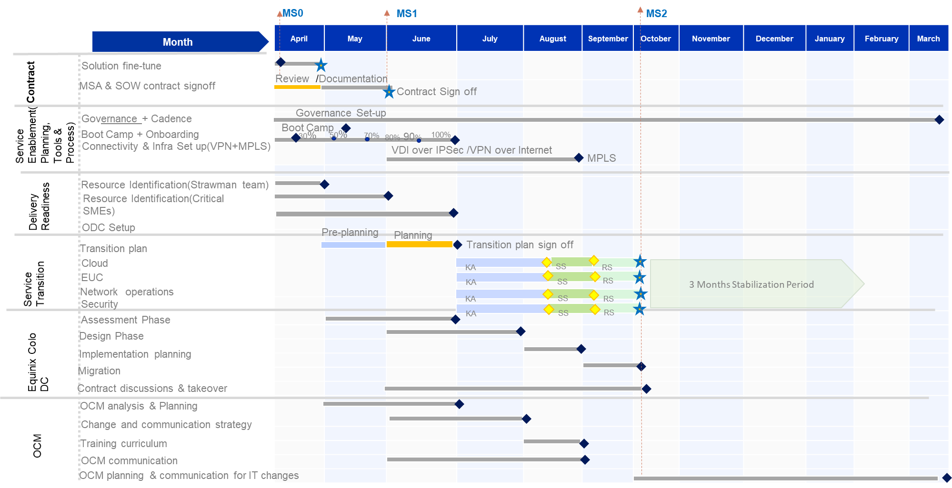
Service Transition and Transformation High level Timeline

Slide 10
Cognizant team expectations
Onshore and offshore associates are expected to provide on call support
Sensitivity towards Bright House SMEs and Incumbent SMEs
Ensure there is minimal impact to BAU due to existing support SMEs involvement in Transition
In KA sessions, stick to the AS-IS scope and any improvements will be done during stabilization
Avoid Scope discussions with the incumbent SMEs (bring it to Management notice)
Take Notes and ensure to send Minutes of the Meeting (use MOM template) to document key communications
Publish artifacts to the customer 24 hours in advance for any meetings / reviews
Give the recipient enough time to respond before following up
Customer Deliverables have to be peer reviewed before submission

Slide 11
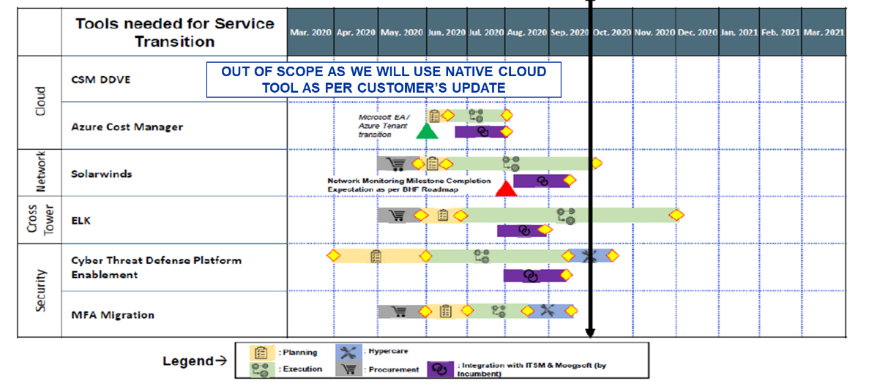
Transformation/Tool Implementation Timeline 1/3

Slide 12
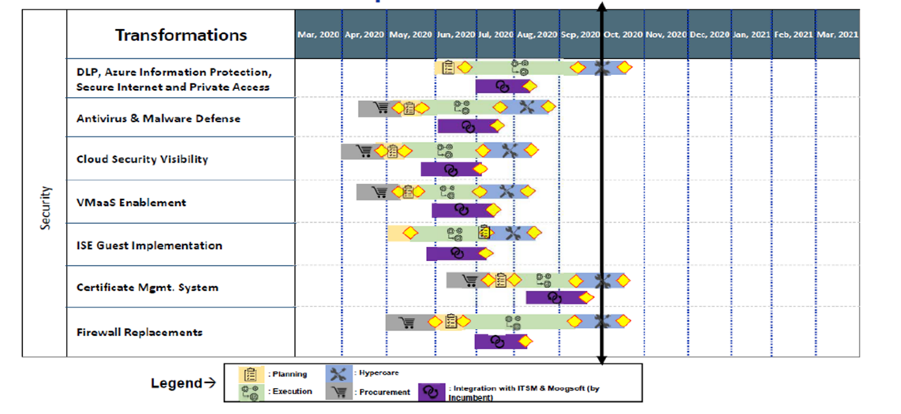
Transformation/Tool Implementation Timeline 2/3

Slide 13
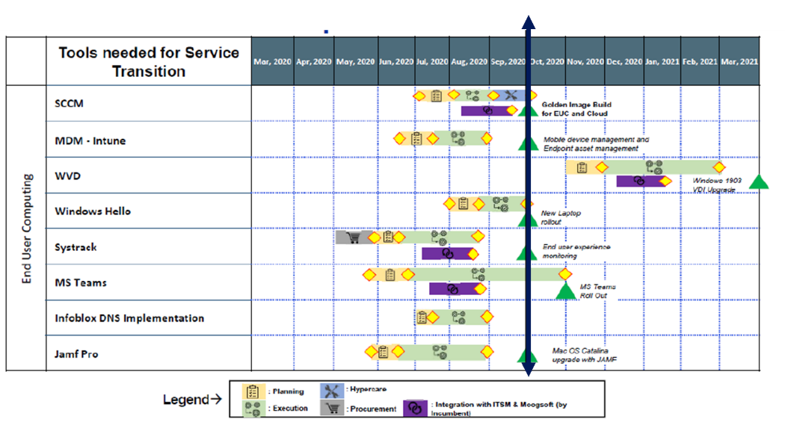
Transformation/Tool Implementation Timeline 3/3

Slide 14
Cloud Computing
Cloud Computing
Service line items | Details
Azure regions | US East and US West
AWS regions | US East 1
Azure: Windows - Prod, UAT, Test | 65
Azure: Windows - Dev | 9
Azure: Linux - Prod, UAT, Test | 0
Azure: Linux - Dev | 1
Azure AD servers | 18
Windows 2016 Web Application Proxy for ADFS | 6
Windows PKI servers | 4
Azure File Server Size in TB | 16
Azure Loadbalancer | 12
AWS: Windows - Prod, | 25
AWS: Windows - Non Prod | 29
AWS: Linux - Prod | 9
AWS: Linux - Non Prod | 11
AWS Windows SQL Instance | 7
AWS Linux DB instance | 3
AWS Loadbalancer | 12
AWS Storage burst capacity - TB | 50
SoftLayer VMs | 96 (Not in Scope)
Tower Specific Tools
BCP/DR
Zabbix – OS, DB & MW Monitoring
ServiceNow – ITSM
IBM Bigfix – Server Patch Management
Cloud native monitoring tools (Azure Monitor & AWS Cloudwatch)
Ansible
Moogsoft – Event Management
Cloud native backups
ServiceNow Reporting & Incumbent provided reporting tools
All business tiers are at Platinum: RPO - <15 min, RTO < 1 Hour
Cloud native tools to support the DR
Annual DR Test for Core Infrastructure
For others, it is based on critical application requirements
Networking & Network Tools
Cloud Connectivity – fully redundant Azure Express Route and AWS Direct Connect through Equinix Cloud Platform.
Service Window
16x5 on floor + on call for P1

Slide 15
Network Services
Network Services
Device/Appliance | Initial Count | Validated Count
Meraki MR53 | 220 | 215
Meraki MX400 | 12 | 4
Meraki MX450 | 2 | 2
Meraki MX100 | 10 | 10
Meraki MS220-8 | 35 | 31
Meraki MS225-24 | 6 | 4
Meraki MS350-24P | 8 | 7
Meraki MS350-48FP | 75 | 76
Meraki MS425-16 | 8 | 8
Cisco ISE | 2 | 2
Cisco ASR 1001 | 4 | 4
Cisco ASA 5500 | 2 | 4
Cisco 3850 | 4 | 4
Cisco Firepower 4120 Series | 4 | 4
Fortigate Firewall | 8 | 10
Cisco 4000 Series | 12 | 0
APC UPS | 12 | 0
Grandstream G Series Analog IP GW | 5 | 0
Infoblox (DHCP) | 7 | 7
15kVA APC UPS 208V | 11 | 1
16kVA APC UPS | 3 | 10
15KVA APC UPS | 1 | 0
Liebert GXT4 10 KVA UPS | 1 | 1
Liebert GXT4 10 KVA UPS | 1 | 1
Liebert GXT4 10 KVA UPS | 1 | 1
Tower Specific Tools
Meraki Dashboard
Netbrain owned by Incumbent
Wireshark
Service Window
16x5 on floor + on call for P1

Slide 16
End User Computing
EUC
Tower | Service line items | Qty
General | Users | 3000
General | Office Locations | 6 (Charlotte, Tampa, Convent Station, NYC, Phoenix, Boston)
General | Application Packages | 12/Month
EUC- Device | VDI - inclusive off hours, weekend on call | 1129
 | HP Elitebook | 1413
 | Apple Macbook /Macbook Pro | 215
Printer | Ricoh Printers MP C3004ex /MP C401 | 46
Polycom Devices | Desk Phone VVX 501 /VVX 601 | 1159
 | Video Conference - Trio 8800 / Trio RP 8800 | 46
Mobile Devices | Android Mobile | 149
 | iOS Mobile | 879
UCC | Skype Numbers | 3000
General | Images Present | Windows 7, Windows 10 (1703, 1805, 1903), MAC OS
O365 | O365 mailbox | 2551
 | SharePoint Sites | 94 Site Collections, 315 Sub sites
 | OneDrive Users (Assumption) | 3000
Tower Specific Tools
MaaS 360 – MDM and Patch Management
Ricoh Follow Me Print – Print Services
Crashplan – Device Backup
ServiceNow – ITSM
Log Me In – Remote Desktop Support
Flexera – Application Packaging
Moogsoft – Event Management
Skype for Business – Collaboration
VMWare Horizon - VDI
ServiceNow Reporting & Incumbent provided reporting tools
Service Window
16x5 on floor + on call for P1

Slide 17
Security Services
Security Services
Service Delivery Locations
Key Volumetric
Cyber Threat Defense – Denver, USA & Chennai, India
Cyber Tools Operation – Chennai, India
Identity Mgmt. Operations – Chennai, India
Data Protection Operations – Chennai, India
Vulnerability Management Operations – Chennai, India
GRC Support Services – Chennai, India
SIEM EPS (Event Per Second) – 2500
IR (Incident Response) Playbooks – 7
Endpoints – 3000
Network & Servers – 778
Public IP Range – Upto 50 IP Address
500 employees & 1000 contractors (guest users)
Firewalls Installed Locations – Boston; Charlotte, New Jersey, New York, Phoneix, Tampa, (SoftLayer – Dallas & Washington DC will be decommissioned)
AWS VPCs – 5; Azure Regions – 2
Domain Controller – 4 in Azure & 4 in IBM Softlayer
CyberArk Agents Installed – 49 systems
Bluecoat Agents Installed – 2925 systems
Carbon Black Agents Installed – 3410 systems
Anyconnect Agents installed – 423 systems
Qualys Agents installed – 3096 systems
RSA tokens installed – 1244
Symantec Endpoint Installed – 2983 systems
External identities – 200,000
Certificates – 6000 (Internal); 200 (External)
Service Window
Service Desk – 24x7x365 (Tier 1)
Cyber Threat Defense – 24x7x365 (Tier1, Tier2 & Tier3)
Cyber Tools Operations – 16x5 business hours and on-call support for P1 incidents (Tier 1.5, Tier2 & Tier3)
Identity Mgmt. Operations; Data Protection Operations – 8x5 (Tier2, Tier3)
Vulnerability Management Operations – 8x5
GRC Support Services – 8x5
Target State Tools
Cyber Threat Defense
IBM QRadar, Anomali, ServiceNow SecOps (SIR)
Cyber Tools Operations
Zscaler Internet Access, Defender DLP, O365 DLP, Zscaler Cloud DLP, O365 Email Security, Proofpoint, Microsoft Defender AV, Carbon Black EDR, Paloalto Firewalls, MCAS, Zscaler Private Access, Cisco ISE
Identity Mgmt. & Data Protection Operations
Open Text, Azure AD, ADFS, Savyint, MS PKI, Azure Key Vault, Venafi, Cyber Ark, RSA, MFA, Azure MFA
Vulnerability Management Operations
Qualys, VMaaS, Checkmarx, Appscan, Metasploit
GRC Support Services
Microsoft security & compliance center, Paloalto Prisma SaaS (Redlock), Proofpoint (Wombat), eDiscovery

